Slide 1
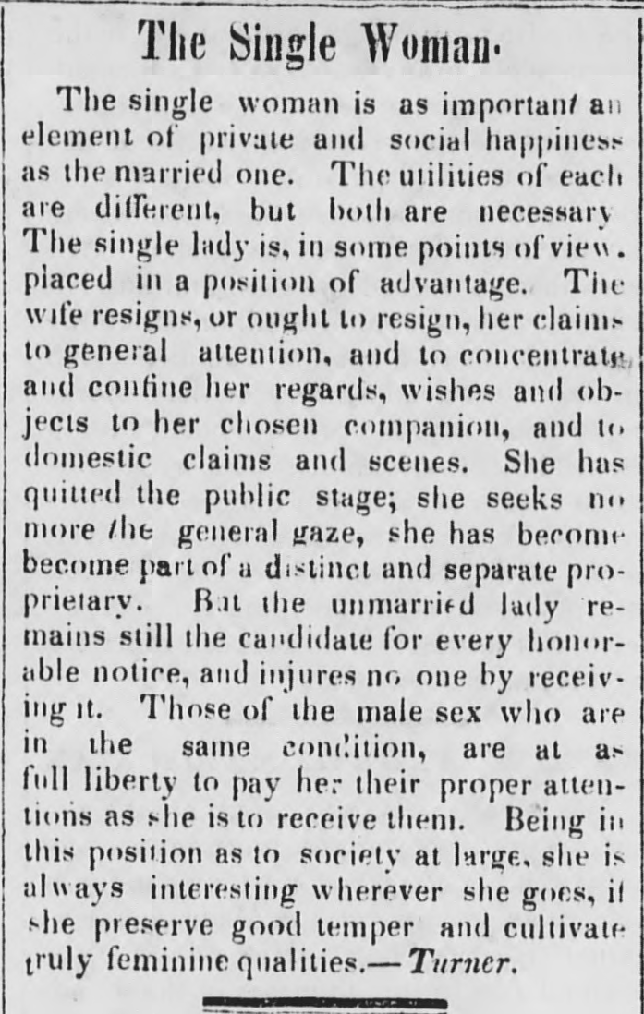
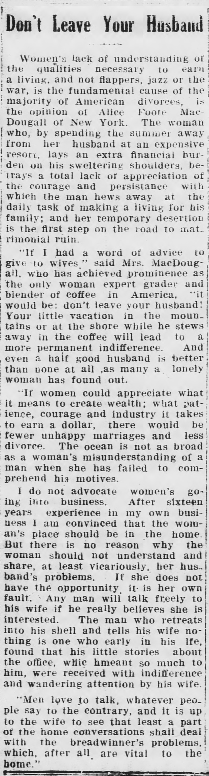
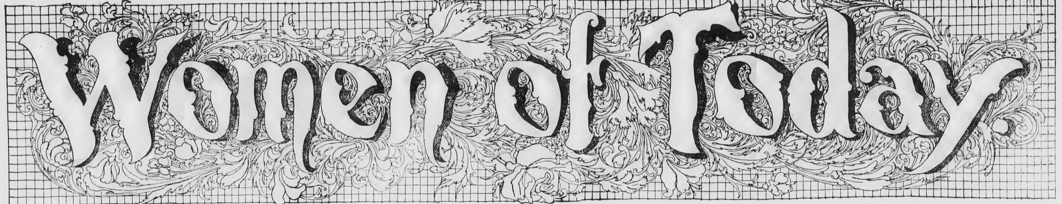
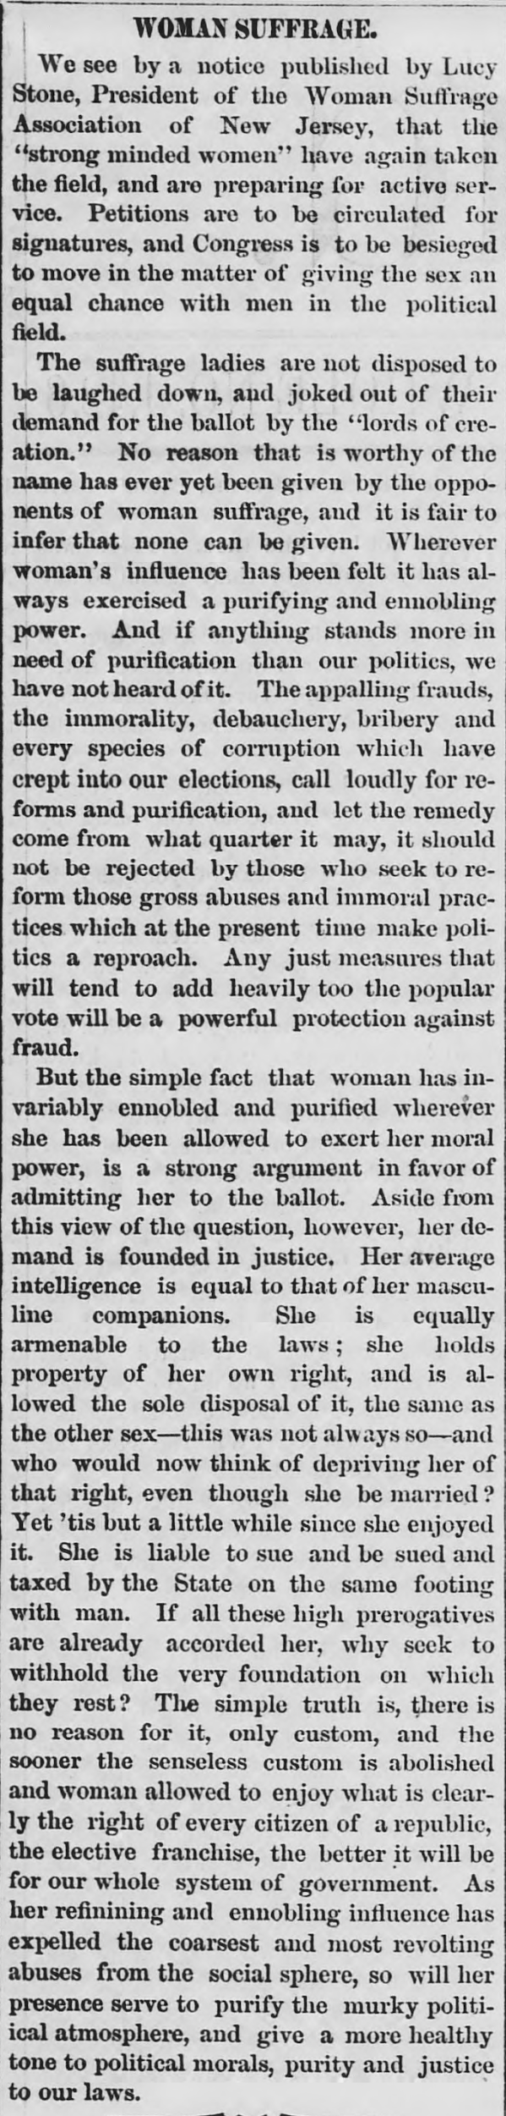
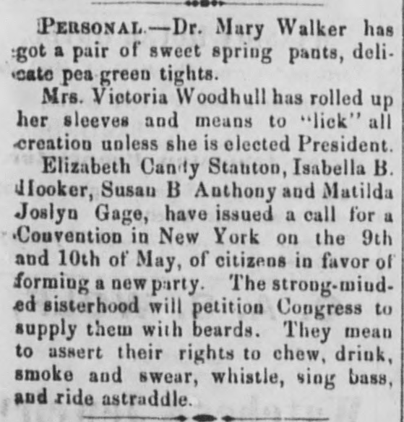
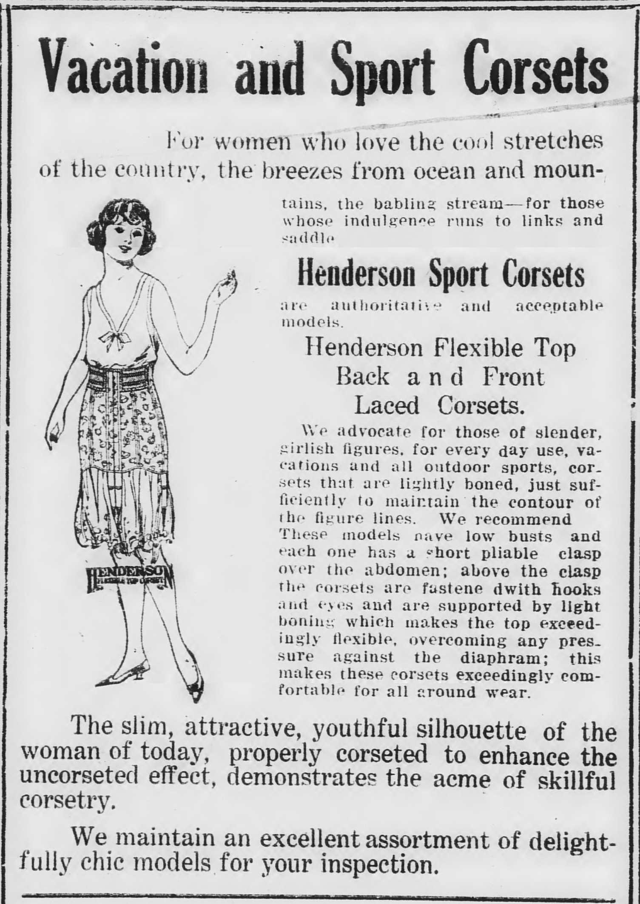
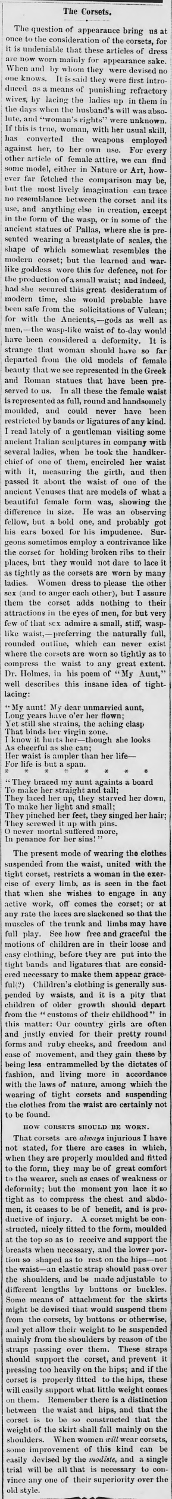
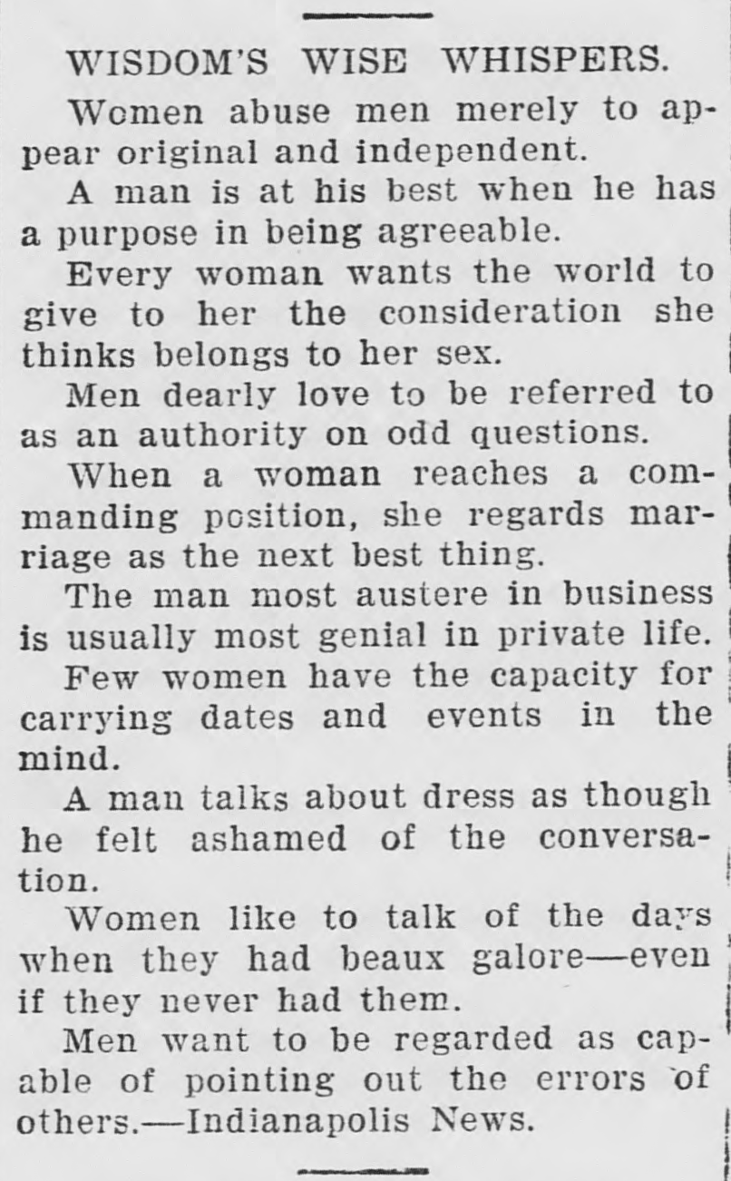
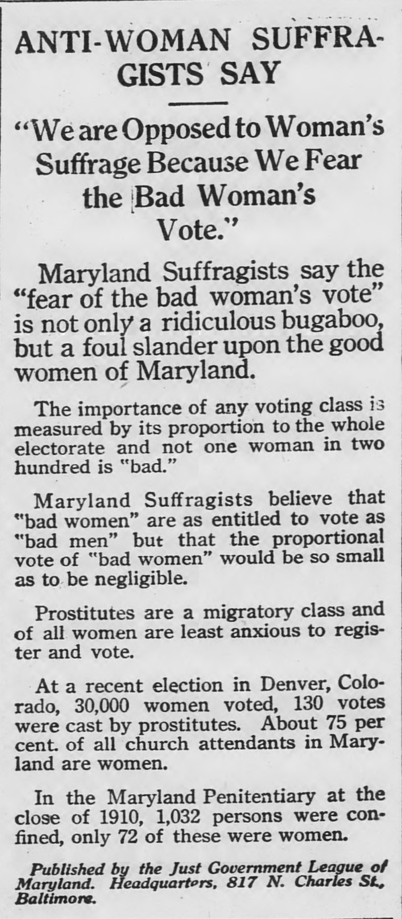
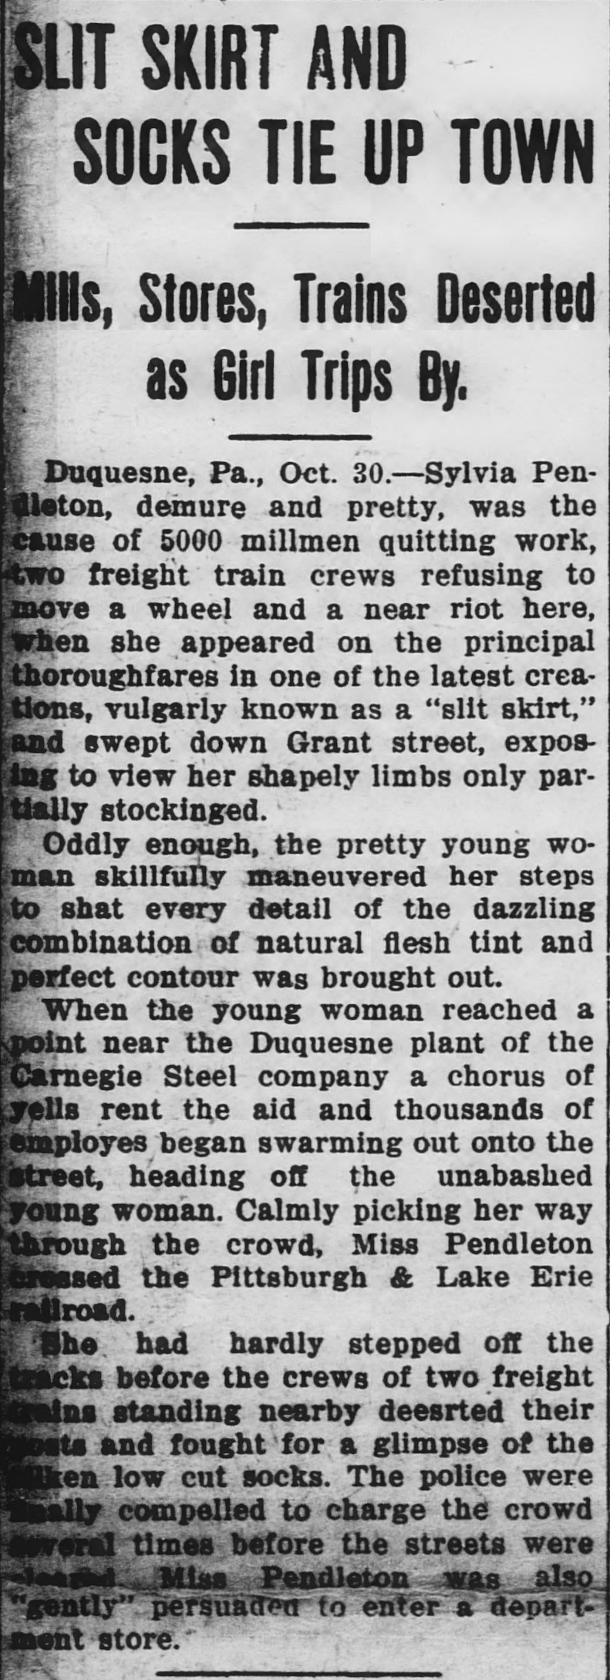
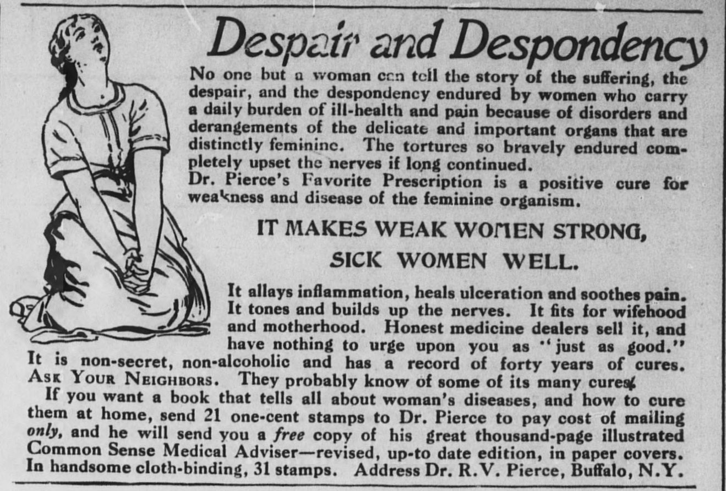
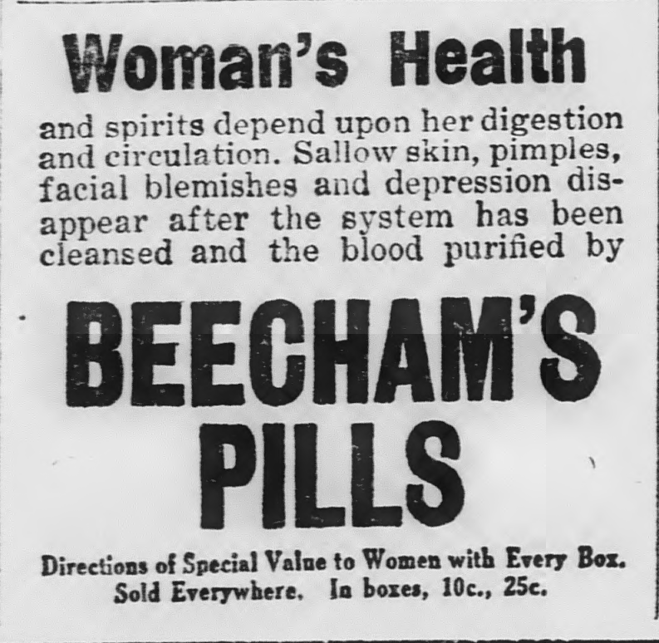
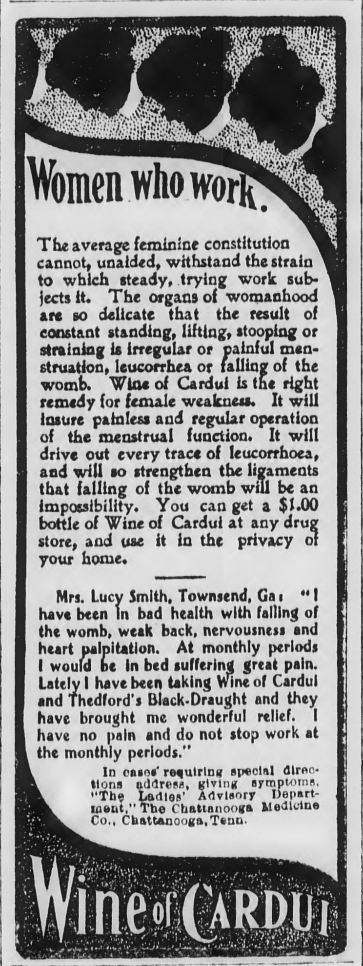

Women and Men
Left Column
A piece found in an 1842 issue of The Cecil Whig, illuminating the necessity of the single woman for “private and social happiness.” Where a married woman with propriety would avoid the attention of all but her husband, an unmarried woman “remains still the candidate for every honorable notice, and indjures no one by receiving it.”
Some “wisdom” regarding men and women circa 1909. Men are known to enjoy being “referred to as an authority on odd questions,” whilst feeling “ashamed” to speak about fashion. Women are known to brag about past suitors, “even if they never had them,” lack the “capacity for carrying dates and events in the mind,” and “abuse men merely to appear original and independent.”
Right Column
Advice from Alice Foote Macdougall in 1922, “the only woman expert grader and blender of coffee in America,” for married women everywhere. “... don’t leave your husband!... even a half good husband is better than none at all, as many a lonely woman has found out.”
A Overview of Women in Historic Maryland Newspapers
Rebecca Wack and Alex Carolan
Historic Maryland Newspapers Project
Women’s Rights
Left Column
An 1868 article arguing for the inevitability and rightness of women’s suffrage. “But the simple fact that woman has invariably ennobled and purified wherever she has been allowed to exert her moral power, is a strong argument in favor of admitting her to the ballot.”
Right Column
The conservative Democratic advocate mocks suffragettes in 1872, announcing “the strong-minded sisterhood will petition Congress to supply them with beards.”
A 1913 advertisement from the Just Government League of Maryland meant to assuage the fears of some opposed to the women’s vote. In an effort to combat claims that “bad” women will throw the vote, the advertisement assures the reader that “Prostitutes are a migratory class and of all women are least anxious to register and vote.”
Women’s Fashion
Left Column
A 1922 advertisement for “sport corsets” designed to help women maintain a “slim, attractive, youthful… silhouette.”
A young woman in a “slit skirt” was responsible for distracting thousands of men from their work as she walked down the street, as “every detail of the dazzling combination of natural flesh tint and perfect contour was brought out.”
Right Column
An 1871 article bemoaning the danger and folly of corsetry. The author believes that women pressure themselves to don the corset, and that their appearance in the eyes of men and other women is placed before their general health and wellbeing.
The Cecil Whig. (Elkton, Md.), 30 April 1842. Chronicling America: Historic American Newspapers. Lib. of Congress. <http://chroniclingamerica.loc.gov/lccn/sn83016348/1842-04-30/ed-1/seq-1/>
The Democratic advocate. (Westminster, Md.), 06 April 1872. Chronicling America: Historic American Newspapers. Lib. of Congress. <http://chroniclingamerica.loc.gov/lccn/sn85038292/1872-04-06/ed-1/seq-3/>
The daily banner. (Cambridge, Md.), 13 May 1922. Chronicling America: Historic American Newspapers. Lib. of Congress. <http://chroniclingamerica.loc.gov/lccn/sn88065731/1922-05-13/ed-1/seq-3/>
The Prince George's enquirer and southern Maryland advertiser. (Upper Marlborough, Md.), 07 May 1909. Chronicling America: Historic American Newspapers. Lib. of Congress. <http://chroniclingamerica.loc.gov/lccn/sn89060124/1909-05-07/ed-1/seq-4/>
The daily banner. (Cambridge, Md.), 03 July 1922. Chronicling America: Historic American Newspapers. Lib. of Congress. <http://chroniclingamerica.loc.gov/lccn/sn88065731/1922-07-03/ed-1/seq-1/>
The Prince George's enquirer and southern Maryland advertiser. (Upper Marlborough, Md.), 16 May 1913. Chronicling America: Historic American Newspapers. Lib. of Congress. <http://chroniclingamerica.loc.gov/lccn/sn89060124/1913-05-16/ed-1/seq-3/>
The daily banner. (Cambridge, Md.), 20 Oct. 1914. Chronicling America: Historic American Newspapers. Lib. of Congress. <http://chroniclingamerica.loc.gov/lccn/sn88065731/1914-10-20/ed-1/seq-4/>
The Cecil Whig. (Elkton, Md.), 21 Nov. 1868. Chronicling America: Historic American Newspapers. Lib. of Congress. <http://chroniclingamerica.loc.gov/lccn/sn83016348/1868-11-21/ed-1/seq-2/>
The Cecil Whig. (Elkton, Md.), 11 Feb. 1911. Chronicling America: Historic American Newspapers. Lib. of Congress. <http://chroniclingamerica.loc.gov/lccn/sn83016348/1911-02-11/ed-1/seq-7/>
Women’s Health
Left Column
“Dr. Pierce” advertised constantly in Maryland papers, with every pitch striking a tone similar to this ad published in 1911. The “despair and despondency” of womanhood could only be cured by Dr. Pierce’s Favorite Prescription.
Center Column
Beecham’s Pills cured everything from acne to depression, both of which were common promises for “medicines” market specifically towards women.
Right Column
Women were often portrayed as hardworking and “frail” or “weak” at the same time. According to this ad for Wine of Cardui, published in 1900, “The average feminine constitution cannot, unaided, withstand the strain to which steady, trying work subjects it.”
The Historic Maryland Newspapers Project is an ongoing effort to digitize Maryland's newspapers and make them accessible for free on the Library of Congress' Chronicling America website. Our project is funded by the National Endowment for the Humanities' (NEH) National Digital Newspaper Program (NDNP) grants. As part of the program, we adhere to NDNP standards for title selection and digitization.
For more information, visit the Chronicling America website at http://chroniclingamerica.loc.gov/, or the HMNP website at http://www.lib.umd.edu/digital/newspapers/home
The daily banner. (Cambridge, Md.), 30 Oct. 1913. Chronicling America: Historic American Newspapers. Lib. of Congress. <http://chroniclingamerica.loc.gov/lccn/sn88065731/1913-10-30/ed-1/seq-1/>
Catoctin clarion. (Mechanicstown, Md.), 28 June 1900. Chronicling America: Historic American Newspapers. Lib. of Congress. <http://chroniclingamerica.loc.gov/lccn/sn84026688/1900-06-28/ed-1/seq-2/>
UNIVERSITY OF MARYLAND LIBRARIES
DIGITAL SYSTEMS AND STEWARDSHIP
DIGITAL CONVERSION & MEDIA REFORMATTING
The Cecil Whig. (Elkton, Md.), 04 Feb. 1871. Chronicling America: Historic American Newspapers. Lib. of Congress. <http://chroniclingamerica.loc.gov/lccn/sn83016348/1871-02-04/ed-1/seq-1/>

