Slide 1
A Fresh Look at the Jim Henson Collection – Via RDA and Linked Data
Kathy Glennan
Head, Authorities and Specialty Cataloging
University of Maryland
March 2, 2016

Slide 2
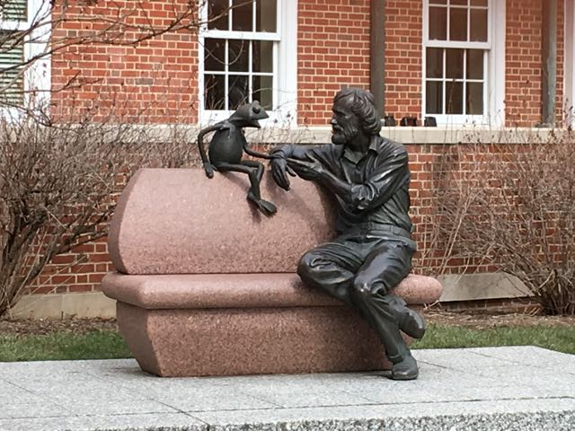
The Jim Henson Collection at UMD
Contains 75 digital videos spanning 35 years of Henson's innovative work in television and film
Gift of The Jane Henson Foundation and The Jim Henson Legacy in 2005
Full-length videos available for viewing at public computer stations in three campus libraries
Collection open for research use, but must be used on site
Henson is an alum, and there’s a statue on campus

Slide 3
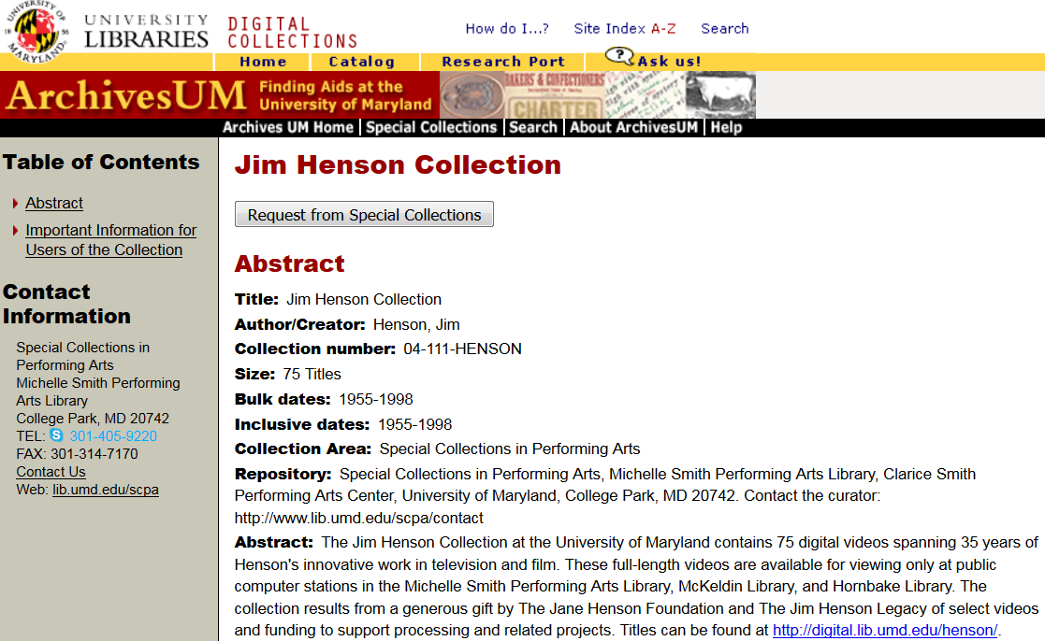
Finding Aid for the Collection
Notes:
This is not a typical finding aid for our collections, since there’s a separate website for accessing the videos. The only part of this site that isn’t displayed here is “Important Information for Users of the Collection”

Slide 4
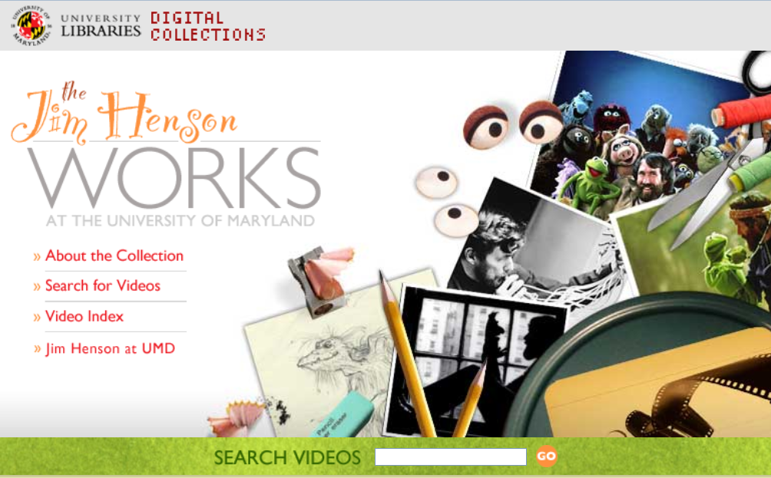
Website for the Collection (http://digital.lib.umd.edu/henson)

Slide 5
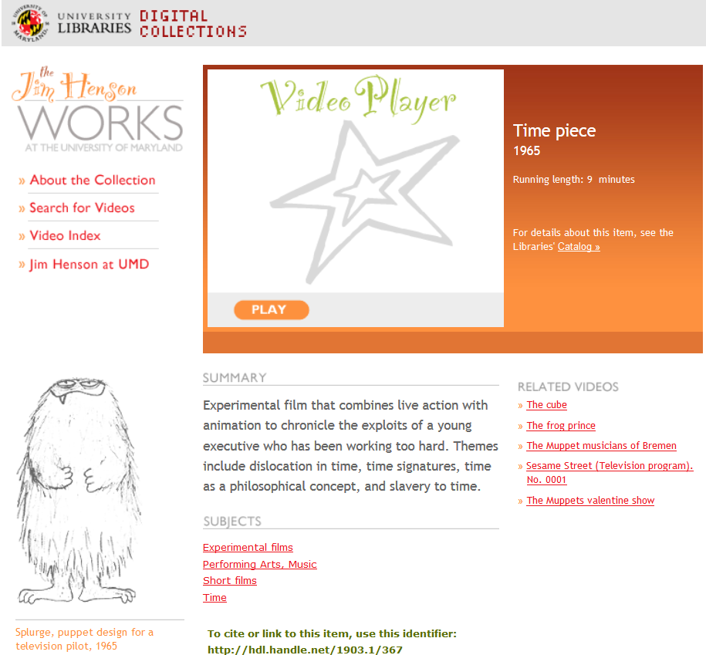
Notes:
The play button launches the video, as long as you’re at an authorized computer – it opens up full screen in a new window
The catalog link takes you to the corresponding MARC record in our OPAC
(Note: our records for this collection are not in OCLC, as part of the deed of gift)
I’m not sure how the related videos are determined
The summary is from the MARC record, as are most of the subject headings – but more on that in a minute

Slide 6
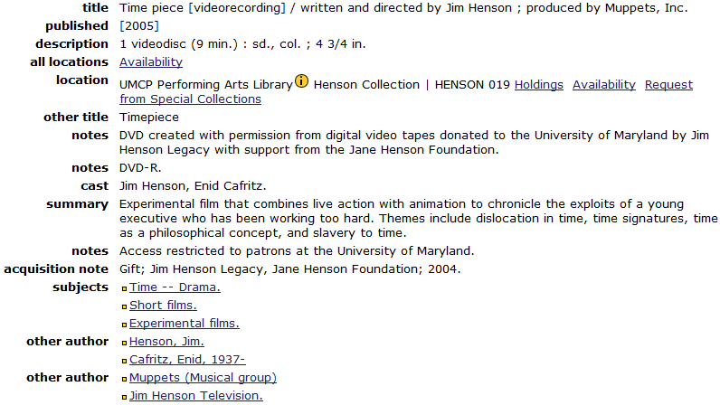
AACR2 / MARC21 Records
Notes:
Performing Arts, Music is not in this record, but is on the website.
With the subject heading Time – Drama: only “Time” is on the website.

Slide 7
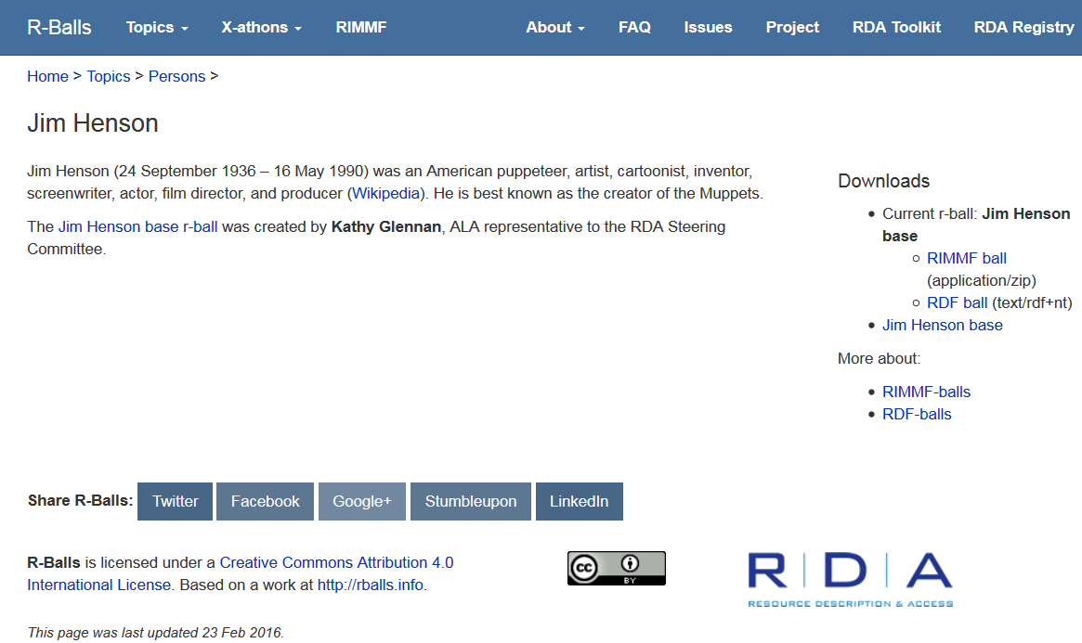
And now, an “r-ball” (http://rballs.info/topics/p/henson/)

Slide 8
So, what’s an “r-ball”?
A collection (or ball) of linked data
Related to a particular entity (so far, just person or work)
Described with RDA
Created using RIMMF (RDA in Many Metadata Formats)
The “r” stands for any/all of the following:
RIMMF
RDA: Resource Description and Access
RDF (Resource Description Framework)
Resource
Record

Slide 9
What’s in an r-ball?
R-balls may contain data for:
RDA elements describing the entity
one or more RDA Works that are related to the entity
one or more RDA Expressions that realize each Work
one or more RDA Manifestations that embody each Expression
one or more RDA Agents (RDA Persons, RDA Families, or RDA Corporate Bodies) that are related to the entity or related Works, Expressions, and Manifestations
You can explore the existing ones – see the guidelines under RIMMF-balls for newbies:
http://rballs.info/about/rimmfballsnewbies.html

Slide 10
What is RIMMF?
A program/tool for creating and editing data compliant with RDA, FRBR, and linked data
Not MARC based
Created & updated by Richard and Deborah Fritz
Freely available: http://www.marcofquality.com/wiki/rimmf
Can ingest MARC bibliographic and authority records, breaking them into entity records for: Manifestations, Works, Persons, Corporate Bodies, etc.
Links the resulting entity records; shows the relationships
Not widely used – at least not yet! But:
Several “Jane-athons” held
MARC output available
Notes:
You can ingest MARC records (and edit them as necessary), create the entity records in RIMMF itself, or some combination of both.

Slide 11
=LDR 01703nam a2200373 4500
=001 umdkpg00000366
=005 20160216101716.0
=008 160216\\\\\\\\\\\\\\\\\\\\\\\\\\\\\eng\d
=035 \\ $a http://hdl.handle.net/1903.1/367
=040 \\ $b eng $e rda
=100 1\ $a Henson, Jim, $d 1936-1990, $e screenwriter.
=245 10 $a Time piece /$c written and directed by Jim Henson ; produced by Muppets, Inc.
=246 3\ $a Timepiece
=264 \1 $a [2005].
=300 \\ $a 1 videodisc : $b color ; $c 4 3/4 in.
=336 \\ $a two-dimensional moving image $2 rdacontent
=337 \\ $a video $2 rdamedia
=338 \\ $a videodisc $2 rdacarrier
=344 \\ $a digital $b optical
=347 \\ $a video file $b DVD video
=500 \\ $a DVD created with permission from digital video tapes donated to the University of Maryland by Jim Henson Legacy with support from the Jane Henson Foundation.
=506 \\ $a Access restricted to patrons at the University of Maryland.
=520 \\ $a Experimental film that combines live action with animation to chronicle the exploits of a young executive who has been working too hard. Themes include dislocation in time, time signatures, time as a philosophical concept, and slavery to time.
=650 \0 $a Time--Drama.
=650 \4 $a Experimental films.
=650 \4 $a Short films.
=700 1\ $a Cafritz, Enid, 1937-,$e actor.
=700 1\ $a Henson, Jim, $d 1936-1990, $e animator.
=700 1\ $a Henson, Jim, $d 1936-1990, $e actor.
=700 1\ $a Henson, Jim, $d 1936-1990, $e director.
=700 1\ $a Nemeth, Ted, $d 1911-1986, $e director of photography.
=700 1\ $a Sahlin, Donald G., 1928-1978, $e special effects provider.
=700 1\ $a Sebesky, Don, 1937-, $e composer (expression).
=710 2\ $a Muppets, Inc., $e producer.
Notes:
MARC Output from RIMMF

Slide 12
Jane-athons?
Half- or full-day workshops using RIMMF to explore using RDA – beyond the limitations of MARC
The first few were focused on Jane Austen
Have held 3 in association with ALA conferences, and several outside the US as well
More planned
Feedback has identified potential areas for improving RDA instructions and elements
Not many “r-balls” or “Jane-athons” have tackled music or AV resources in depth
But a brief “Lenny-athon” will be part of MLA’s Digital Humanities session on Saturday morning
Notes:
14 April 2016, National Library of Spain, Madrid: Cervathon (topic: Miguel de Cervantes) 4 May 2016, BnF, Paris: French X-athon 9 May 2016, National Library of Sweden, Stockholm: Selma-thon 1 (topic: Selma Lagerlöf) 10 May 2016, National Library of Sweden, Stockholm: Selma-thon 2 24 May 2016, EURIG/National Library of Latvia, Riga: Riga-thon (topic: Vaira Vīķe-Freiberga) 23 June 2016, Orlando, USA: Lang-athon (multilingual aspects of RDA and RIMMF)

Slide 13
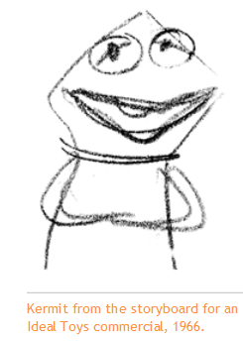
Jim Henson r-ball
A good way to compare the data from more traditional finding aids with a set of related linked data
Includes the 75 videos, along with related books, digital photographs, etc. – mostly imported from UMD’s local system
Contains 798 entity records:
99 works
93 expressions
103 manifestations
437 persons
66 corporate bodies
Notes:
Some work records don’t have corresponding expression records because they are “related works” for a collection of clips from various talk shows: the Jack Paar program, Tonight! with Steve Allen, the Jimmy Dean show, the Ed Sullivan show, and the Dick Cavett show

Slide 14
A closer look at RIMMF

Slide 15
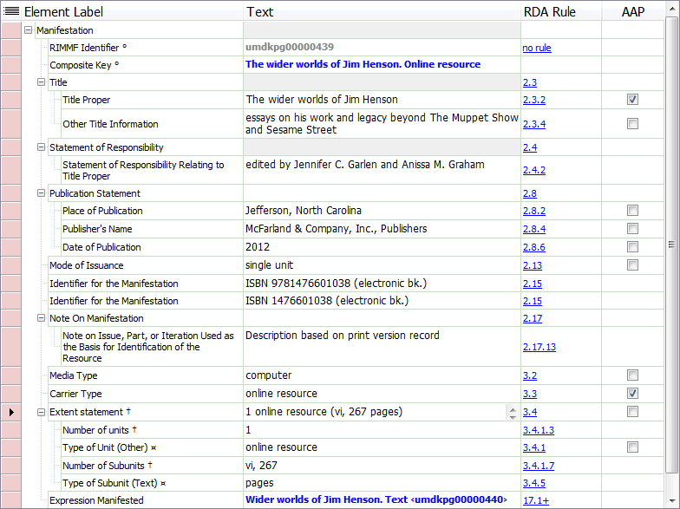
Manifestation record in RIMMF

Slide 16
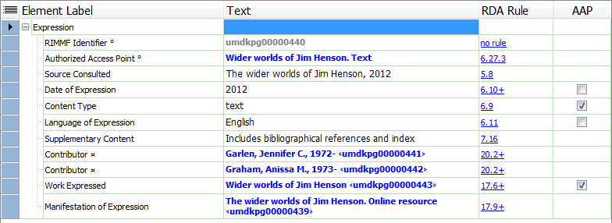
Expression Record in RIMMF

Slide 17
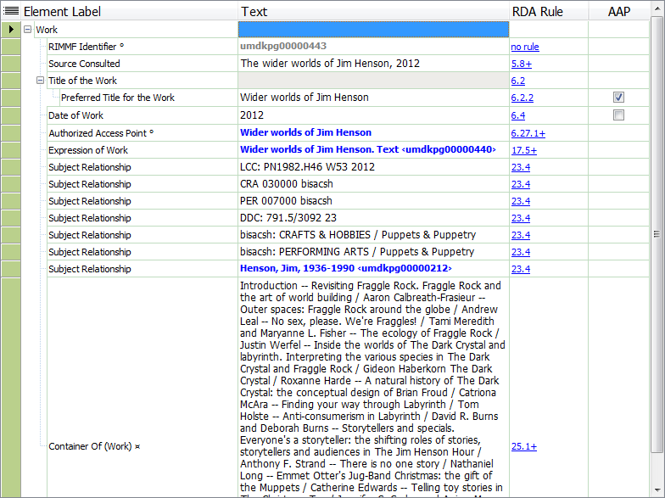
Work Record in RIMMF
Notes:
RIMMF built this work record based on information in the original bibliographic record.
The subject relationships were created based on the 050, 072 and 6XX fields, with labels for identification of the type of subject.

Slide 18
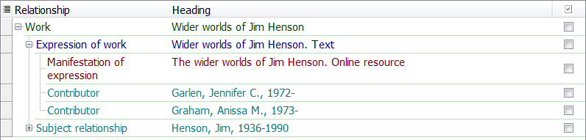
Work Tree Visualization in RIMMF

Slide 19
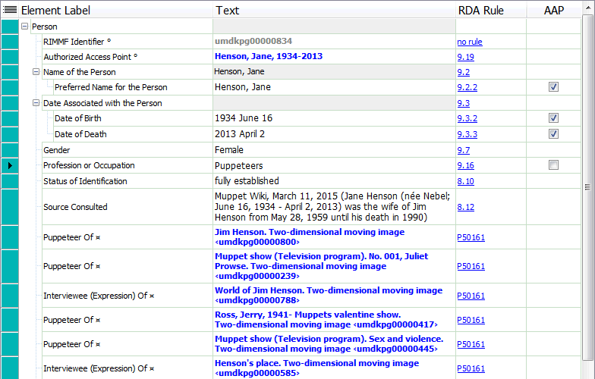
Person Record in RIMMF
Notes:
The non-RDA “RDA rule” references link to the RDA Registry. They represent relationship designators that have been defined only in one direction in the RDA Toolkit – but obviously the relationship goes both ways. (Work to person; person to work)

Slide 20
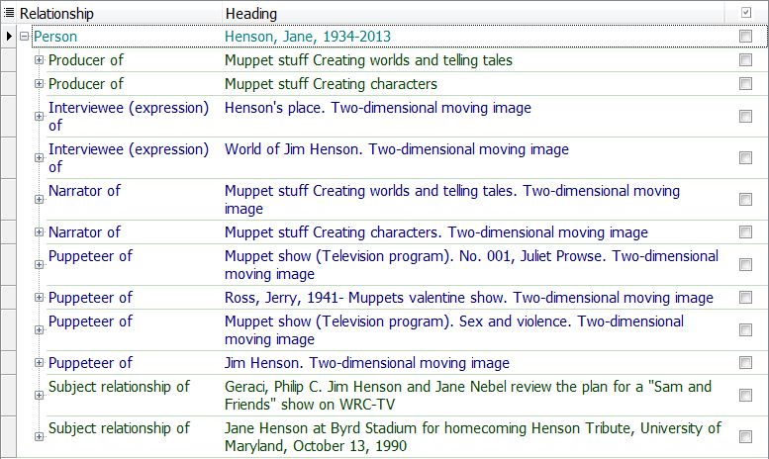
Person Tree Visualization in RIMMF
Notes:
Complete

Slide 21
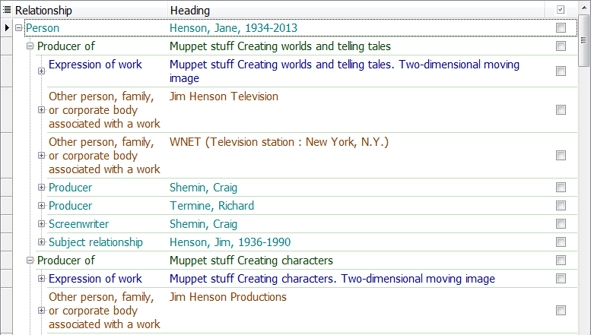
Person Expanded Tree Visualization
Notes:
Full for 1st work, partial for 2nd

Slide 22
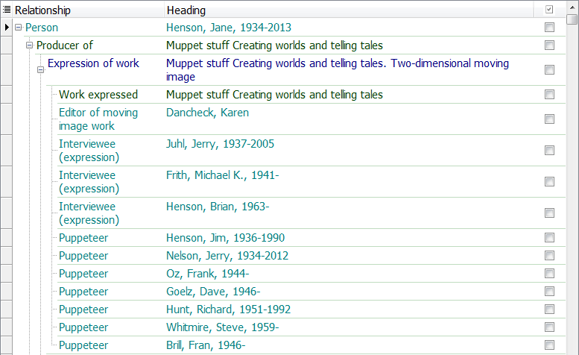
More Person Tree Expansion
Notes:
Partial entity relationships for 1st work

Slide 23
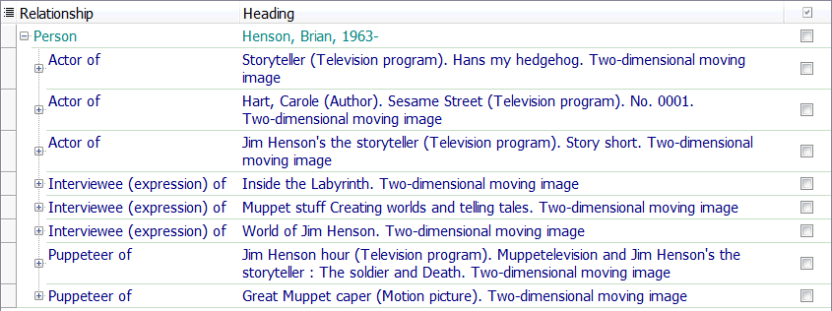
Related Person Tree

Slide 24
Other visualizations of linked data?

Slide 25
Linked data graphs
Problems with bibliographic data visualizations
There aren’t many free visualization tools for bibliographic data
For meaningful displays, the data needs to be massaged
Bibliographic data can have very detailed relationships
From a RIMMF perspective, every entry in an entity record is a relationship to that entity
This makes graphs very big, very quickly
More programming work needed to improve visualizations of our complex data
Notes:
I hoped to give you a visualization of how RDF triples can be displayed to show relationships that a set of corresponding MARC records don’t make explicit, but…

Slide 26
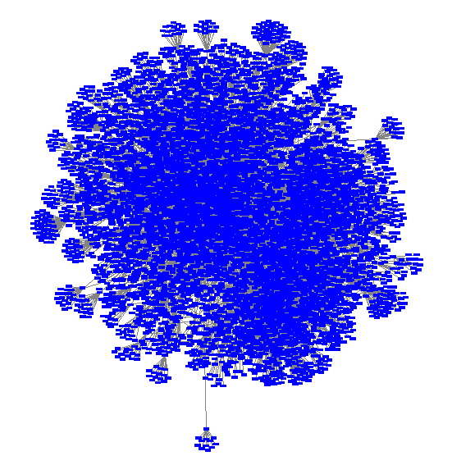
Henson r-ball: Very Busy!
Notes:
Not too surprising. There are 798 entity records, but over 14,000 relationships in this r-ball.

Slide 27
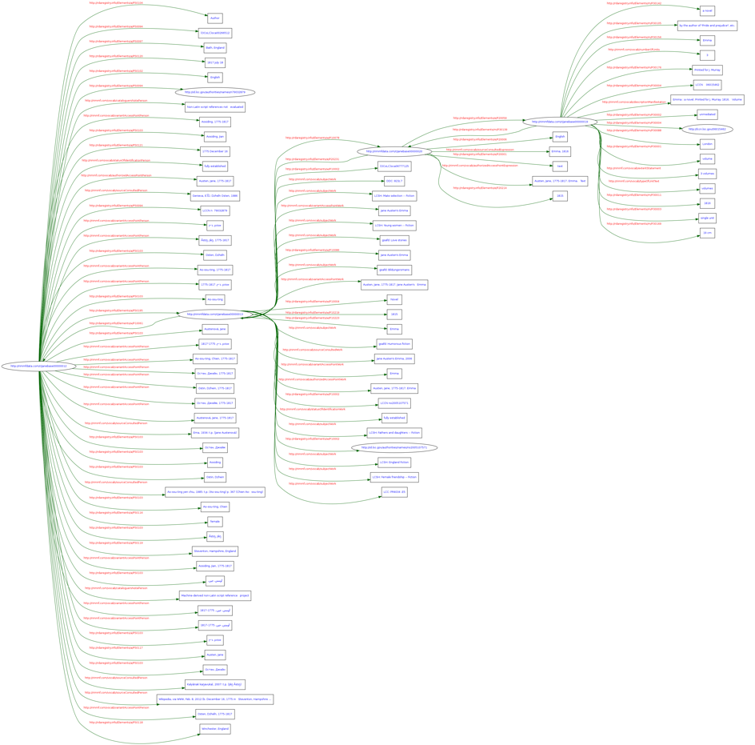
Graph of 4 records: Austen’s Emma
http://rballs.info/images/janeemmaur.png

Slide 28
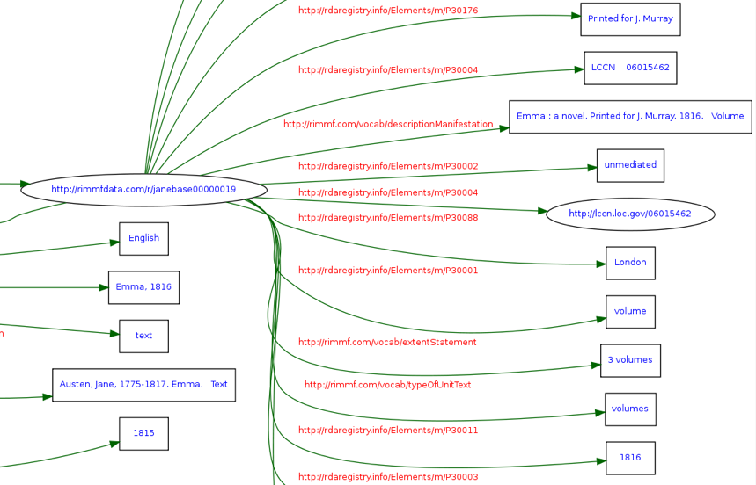
A closer look

Slide 29
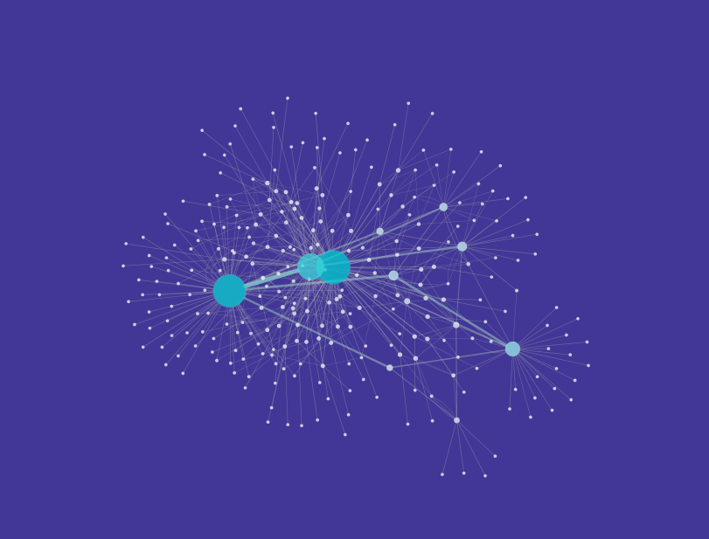
This is only 5 entity records

Slide 30
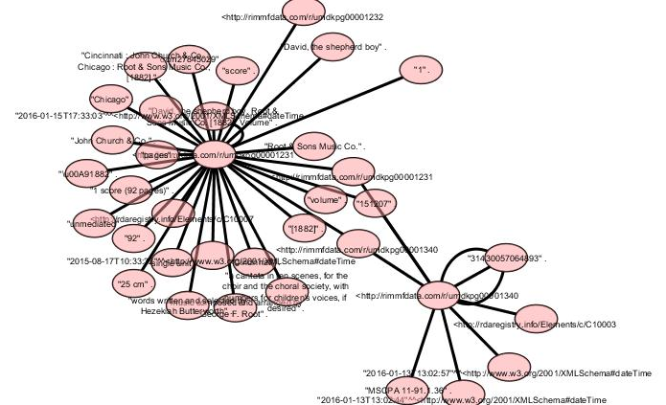
A subset of those (just 2)

Slide 31
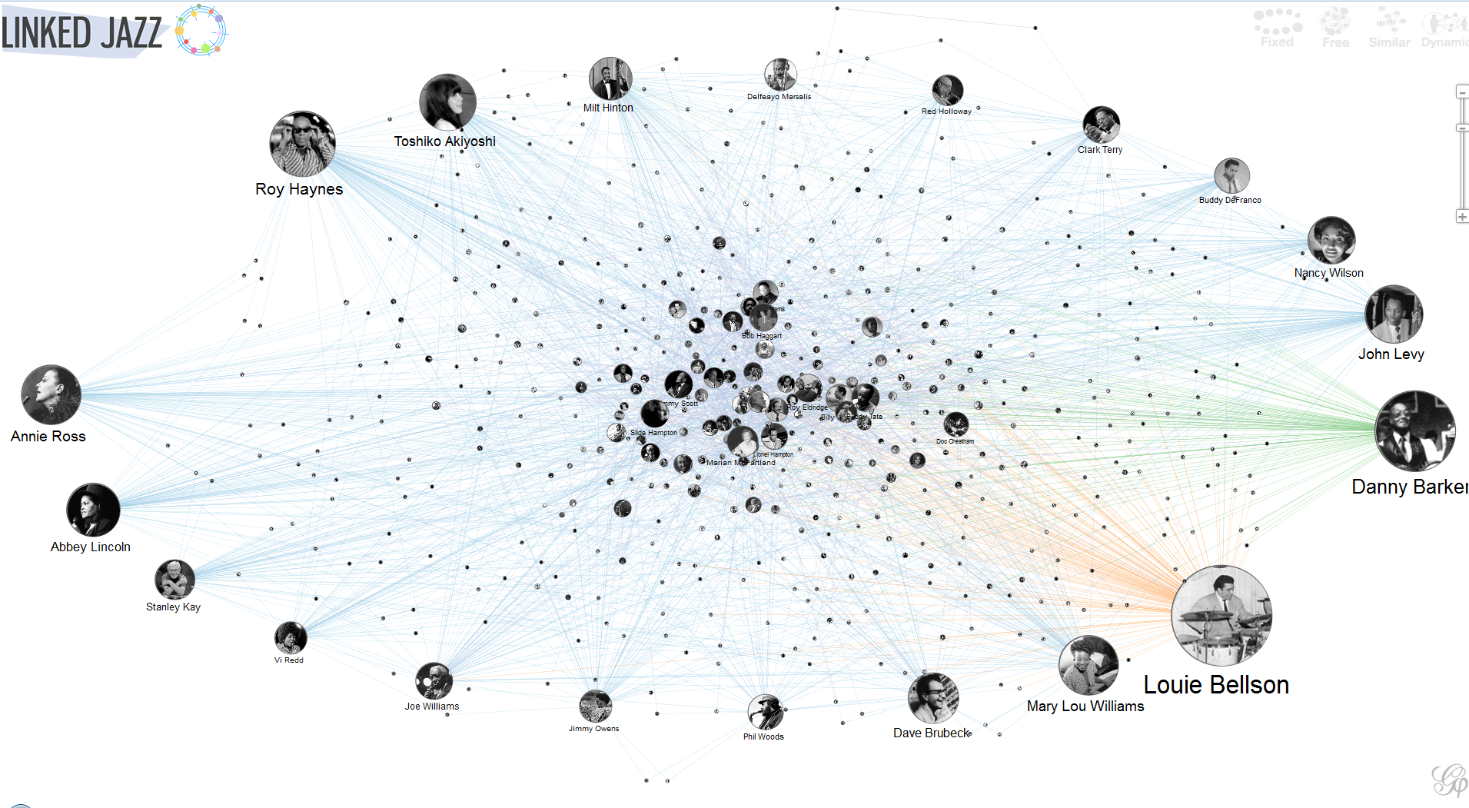
We still have a ways to go….

Slide 32
Data Challenges when using RIMMF
Identifying which element goes where
If ingesting MARC, sometimes data elements need to be moved from one entity record to another, and cataloger’s judgment comes in to play
Getting out of MARC thinking – and provider neutral guidelines, etc.
RIMMF allows for “pure” RDA implementation, without compromises made for MARC and local systems
Discovering that there aren’t relationship designators for everything – like puppet builders
Notes:
Where does "Entire original production directed and choreographed by Jerome Robbins“ belong in the WEMI stack anyway?
Is there a relationship here? More than one?

Slide 33
Data Opportunities
More granularity in records
Separate data elements display and function more clearly
Greater specificity of relationships and roles
Frank Oz as director, producer, screenwriter, actor, interviewee and puppeteer
Determining what to display as the AAP:
Henson, Jim [LC/NACO Authority File] or Henson, Jim, 1936-1990 [my r-ball]
Notes:
The RIMMF AAP functionality offers the same type of customization for works and expressions

Slide 34
What about a music-related r-ball?

Slide 35
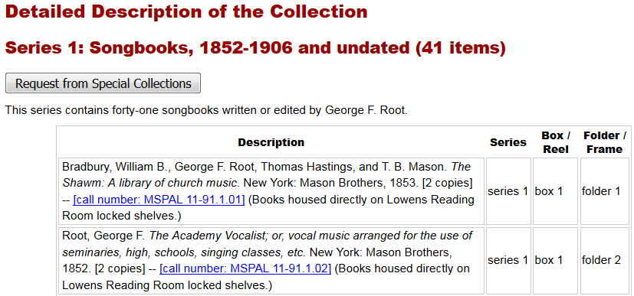
George F. Root Songbook Collection
Based on resources in UMD’s Special Collections in the Performing Arts
Now available: http://rballs.info/topics/p/gfroot/
Notes:
Excerpt from ArchivesUM – a more traditional finding aid than with the Henson collection. The songbooks in this collection have corresponding MARC bib records; these formed the basis of the r-ball.
In this case, the call number hotlinks connect to our record in WorldCat Discovery

Slide 36
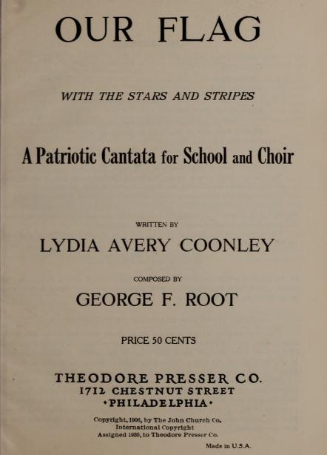
Root Entity Record Count
232 Records:
43 Works
45 Expressions
60 Manifestations
61 Items
22 Persons
1 Corporate Body
Over 3600 relationships

Slide 37
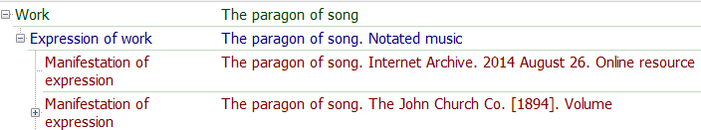
Challenges with the Songbooks
Dealing with print resources, most of which are digitized
Some by UMD
Entity records created – full relationship shown in RIMMF
Some by other libraries
Links provided in the manifestation record; relationship only shown there

Slide 38
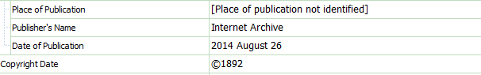
Challenges
Describing electronic reproductions
Who is the publisher?
What is the date of publication?
Can this be right?
How specific should the extent statement be?
1 online resource
1 online resource (1 score)
1 online resource (1 score (192 pages))

Slide 39
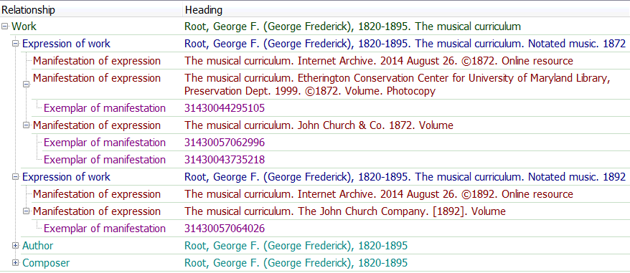
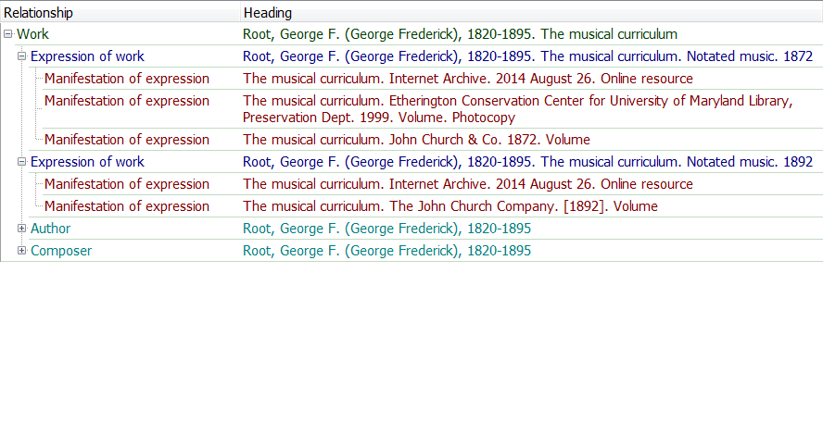
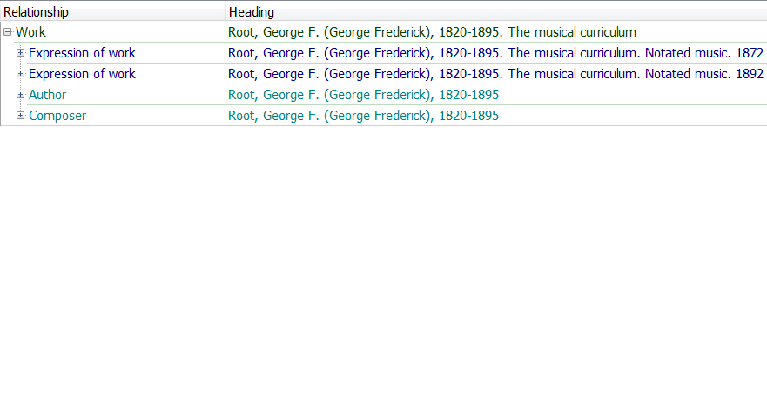
Challenges
Representing editions/reproductions in a meaningful way

Slide 40
Challenges
One person, multiple roles – such as
“selected, compiled, or composed by George F. Root”
What solution is best?
Single broad relationship designator – maybe “author”?
Multiple relationship designators, which could be in different entity records
Composer – work record
Compiler – work record
Editor – expression record
Notes:
What if Root isn’t the only composer?
Still identify as such, and don’t worry about identifying the others?
What if this wasn’t a special collection?

Slide 41
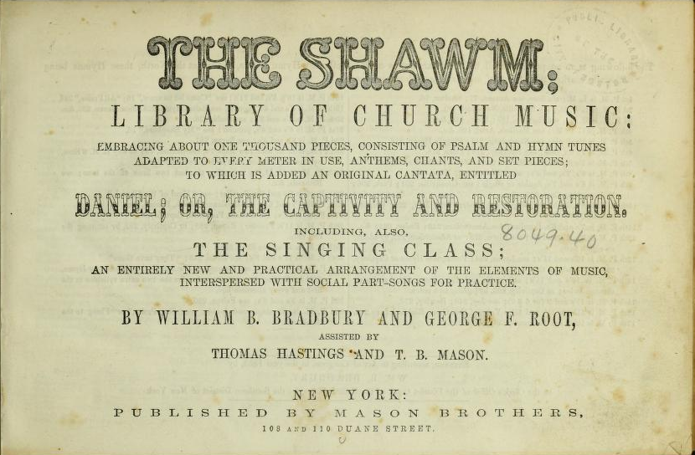
And then there are Aggregates…

Slide 42
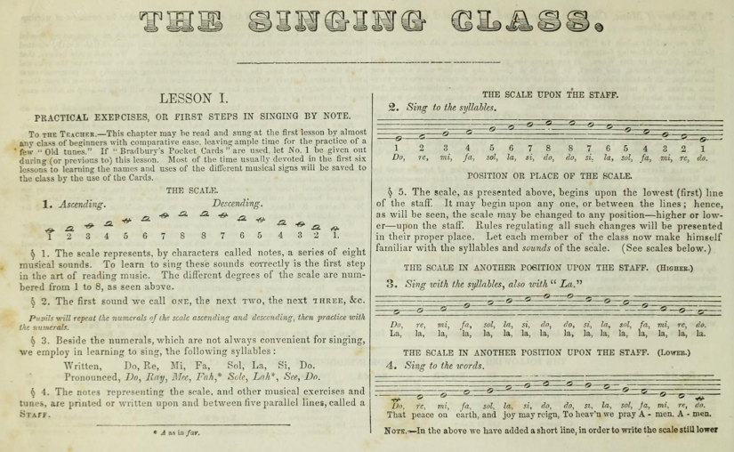
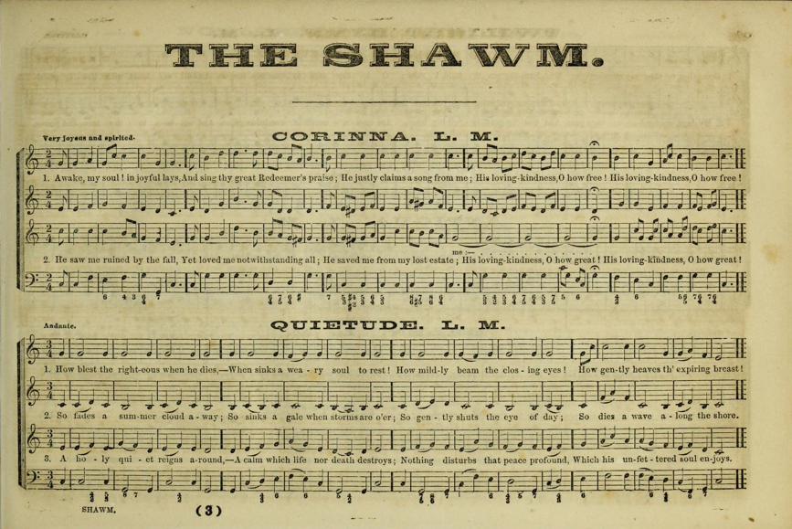
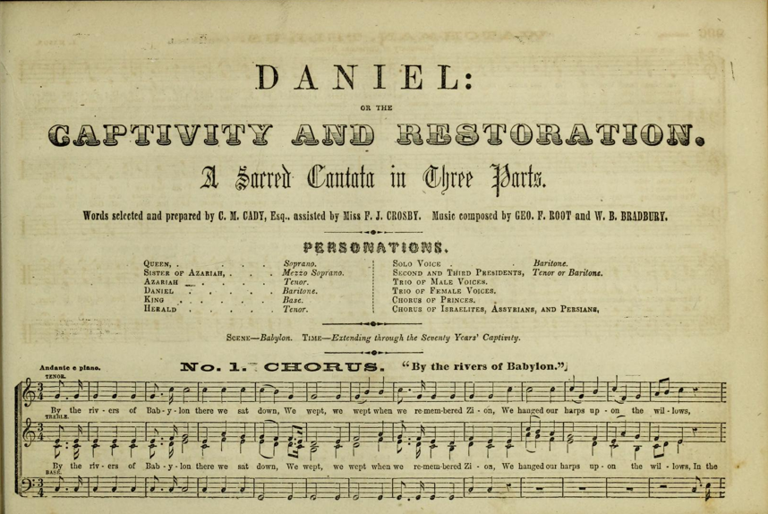
Perhaps a Worst Case Scenario
The Shawm always includes:
Notes:
RDA doesn’t deal well with aggregates at this point; the RSC Aggregates Working Group is continuing to investigate this situation.
As an aside, depending on how “aggregate” is defined, just about everything falls into this category (a song: music + text; a book with a preface; a CD; etc.)
In this case, let’s look at the obvious...

Slide 43
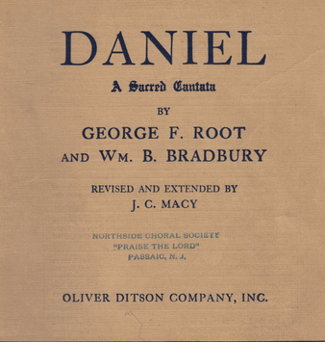
What a mess!
The singing class is less than 30 pages
Essentially a method book
Probably doesn’t need identification as a separate work
The shawm [section] runs from page 33-296
Shares its title with the resource itself
But probably doesn’t need to be identified separately
Daniel appears on pages 297-346
It has also been published separately
With some variants from this version
UMD doesn’t own the separate publication
Merits its own set of entity records
Which WEMI level should hold the relationships?
Notes:
From the preface to A-R Edition’s 1984 publication of Root’s cantata, The Haymakers:
Daniel, or, The Captivity and Restoration was first printed as a part of William Bradbury’s popular collection The Shawm (two numbers were removed from Root’s cantata and music by Bradbury inserted in their places so that the cantata would be partially attributable to Bradbury), but the demand for the cantata was so great that it soon was published separately.
I settled on using both contained in (work) & contained in (expression)

Slide 44
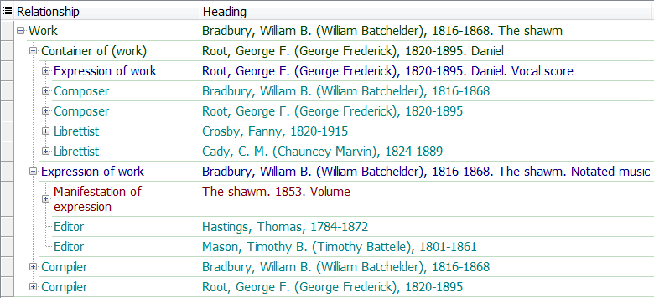
Complex Relationships

Slide 45
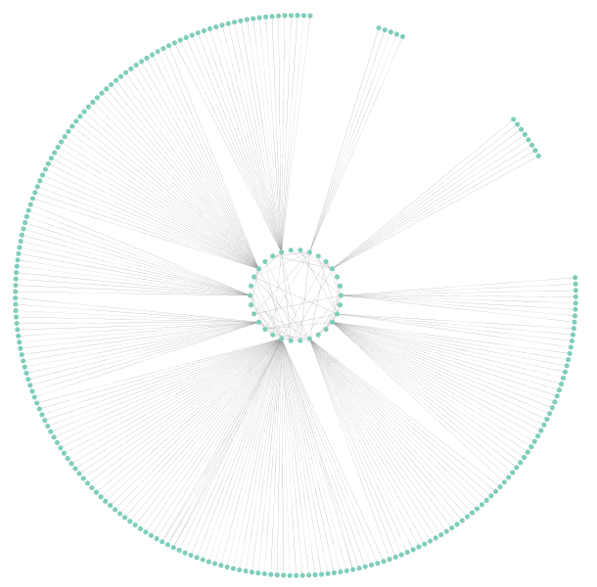
And in a graph…

Slide 46
Questions?

